Slide 1
Jackpot Semester Project Report

Slide 2
Our team partners
Mohammad Hassan Khan (200901086)
M. Hamza Farooq (200901019)
Danyal Shah (200901046)
Abdullah Ashar (200901074)
Abdullah Hussain (200901042)
Asad Ullah Khan (200901096)

Slide 3
Table of contents
01
04
About the project
Output Result
02
05
Problem Statement
Conclusion
03
Methodology

Slide 4
01
About the project
Jackpot Introduction

Slide 5
Jackpot is a widely popular and well-respected turn-based centuries-old casino game.
Trains one to use all the resources to the maximum extent.
Designing an advanced and innovative Jackpot game which is based on the concept of one of the most played game in casinos in the real life.
Purpose of the project is to create a dynamic Jackpot game which provides the users with the ability to win bigger reward by just playing this game in their home or in casinos.
The user will start playing this game by just 1$, with the initial balance of 1000$.
After that the user is prompted if he/she wants to continue the game considering the current balance.
The result will be displayed in a slot machine.

Slide 6
02
Problem Statement

Slide 7
The Jackpot game provides a predictable long-term advantage to the casino, or "house", while offering the players the possibility of a short-term gain that in some cases can be large.
Some jackpot games have a skill element, where the players' decisions have an impact on the results.
Making an improved jackpot game which will allow player to re do a spin

Slide 8
03
Methodology

Slide 9
This project uses the Python programming language to implement the Jackpot game.
These practical problems improve the manipulative ability.
Details of the problem and decomposing things into various objects to solve through the development of the jackpot game is observed.
Python: More suitable for large-scale casino games such as the Jackpot game which includes multi-task, multi-factor, and multi-requirement.
Enhances the programming skills through logic development and helps to design and implement classes along with member functions, and constructors.
A user-friendly environment for the players to compete by their manipulative ability.
Its engines capable of playing the game and analyzing its positions in case of any invalid move attempted by one of the players.

Slide 10
Jackpot stages
Stage 1
Stage 2
Stage 3
Asks the player
Spins the wheel and displays it.
Prints the score.

Slide 11
04
Output

Slide 12
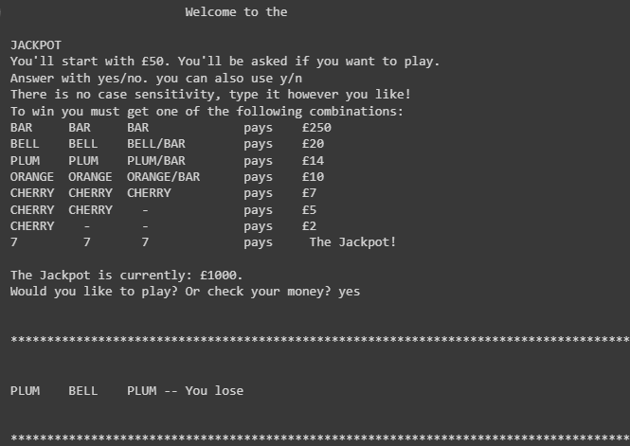
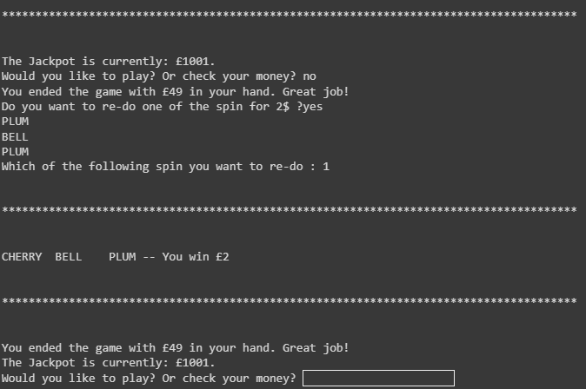
Sneak peek

Slide 13
05
Conclusion

Slide 14
We have successfully completed our ‘Data Structurers and Algorithms’ semester project on “The Jackpot” game in Python language using PyCharm.
A user-friendly jackpot game as this will provide the user an opportunity to double the chance of winning the game.
If a user loses in first attempt, he will get the chance of winning that bet again by the re-do option.
This type of jackpot game is never invented before so producing this game in casinos will make people love playing this game.

Slide 15
Thanks for Watching
Do you have any questions?

